Slide 1
Becker Professional Theology Academy
B100 – Module 5.1 – Baptism
(John the Baptist)
Course Creator – Kathy L. McFarland
http://becker.academy/moodle/

Slide 2
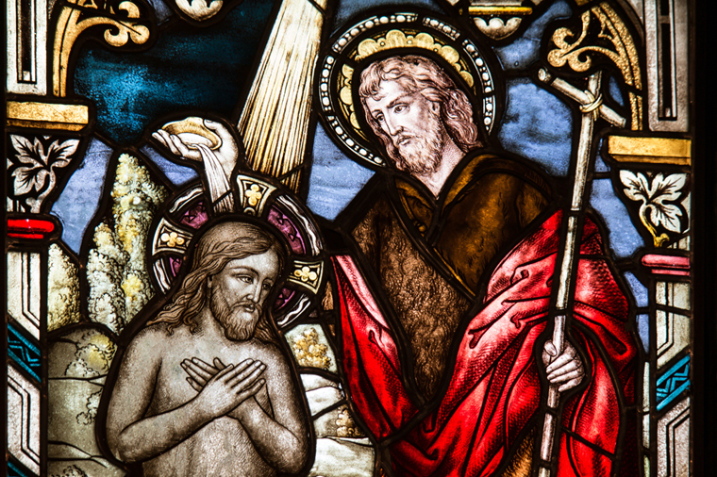
There was in the days of Herod, the king of Judaea, a certain priest named Zacharias, of the course of Abia: and his wife was of the daughters of Aaron, and her name was Elisabeth. And they were both righteous before God, walking in all the commandments and ordinances of the Lord blameless. And they had no child, because that Elisabeth was barren, and they both were now well stricken in years. (Luke 1:5–7)
Zacharias is the father of John the Baptist and Elisabeth is his mother.
John’s parents were righteous and walked in the commandments and ordinances of the Lord
John’s parents were blameless of sin
Zacharias was an important priest that served God in the Temple
Zacharias and Elisabeth were very old, and she was barren
Their old age became an important testimony of God’s providence
John the Baptist would one day baptize His Lord Jesus Christ

Slide 3
And it came to pass, that while he executed the priest’s office before God in the order of his course, According to the custom of the priest’s office, his lot was to burn incense when he went into the temple of the Lord. And the whole multitude of the people were praying without at the time of incense. And there appeared unto him an angel of the Lord standing on the right side of the altar of incense. (Luke 1:8–11)
Advanced students of Professional Theology study the important typological connections within God's Word. But, the training begins with the little pieces of solid foundation gleaned from literal representation of biblical things.
While executing duties as Temple Priest, Zacharias saw the Angel of the Lord
The Angel of the Lord stood on the right side of the altar of incense
A multitude were praying outside the Temple as the Angel of the Lord manifested
The Angel of the Lord appearing at the burning of incense is typologically significant

Slide 4
And when Zacharias saw him, he was troubled, and fear fell upon him. But the angel said unto him, Fear not, Zacharias: for thy prayer is heard; and thy wife Elisabeth shall bear thee a son, and thou shalt call his name John. And thou shalt have joy and gladness; and many shall rejoice at his birth. For he shall be great in the sight of the Lord, and shall drink neither wine nor strong drink; and he shall be filled with the Holy Ghost, even from his mother’s womb.(Luke 1:12-15)
Zacharias was scared and troubled by the Angel of the Lord
The Angel of the Lord arrived because of Zacharias’ prayer for offspring
The Angel of the Lord announced that Elisabeth would bear a son
They would conceive a baby and he was named John by the LORD God

Slide 5
And thou shalt have joy and gladness; and many shall rejoice at his birth. For he shall be great in the sight of the Lord, and shall drink neither wine nor strong drink; and he shall be filled with the Holy Ghost, even from his mother’s womb. For he shall be great in the sight of the Lord, and shall drink neither wine nor strong drink; and he shall be filled with the Holy Ghost, even from his mother’s womb. And many of the children of Israel shall he turn to the Lord their God. And he shall go before him in the spirit and power of Elias, to turn the hearts of the fathers to the children, and the disobedient to the wisdom of the just; to make ready a people prepared for the Lord. (Luke 1:14–17)
EIGHT PROPHECIES
About
John the Baptist
Great in the sight of the Lord
Will drink neither wine nor strong drink
Filled by the
Holy Ghost in his
mother’s womb
Will turn many children of Israel to the LORD God
Shall have the spirit and power of Elijah
Will turn the hearts of the fathers
to the children
Will turn the disobedient to the wisdom of the just
Will make ready a people prepared for the Lord

Slide 6
And Zacharias said unto the angel, Whereby shall I know this? for I am an old man, and my wife well stricken in years. And the angel answering said unto him, I am Gabriel, that stand in the presence of God; and am sent to speak unto thee, and to shew thee these glad tidings. And, behold, thou shalt be dumb, and not able to speak, until the day that these things shall be performed, because thou believest not my words, which shall be fulfilled in their season. (Luke 1:18–20)
Angel Gabriel is an angel that stands in the presence of the LORD God
Zacharias did not believe the Angel because he and his wife were too old to conceive.
Angel of the Lord Gabriel was sent by the LORD God to Zacharias
Angel Gabriel made Zacharias unable to speak because of his disbelief
The Angel of the Lord’s name is Gabriel
Zacharias remained in the diminished non-speaking condition…
…until the
Angel of the Lord’s prophecy had been fulfilled

Slide 7
And the people waited for Zacharias, and marveled that he tarried so long in the temple. And when he came out, he could not speak unto them: and they perceived that he had seen a vision in the temple: for he beckoned unto them, and remained speechless. (Luke 1:21–22)
The head priest would usually enter the Temple, and leave quickly in order to for his sanctified human body to survive being in the presence of the LORD God whose essence dwelt in the Ark of the Covenant.
A traditional story addition (not recorded in Scripture) of Judaism speaks of how they would get the dead Priest out of the Temple, should he expire through being enveloped in the tremendous power of the essence of the LORD God (since it was only the High Priest that was pure enough to enter into the Temple and see God). Some Rabbis subscribed to the “rope tied on the ankle of the Priest” as he entered the Holy Tabernacle of God, that would allow rescuers to pull him out of God’s presence and the Temple if he died.
The multitude standing outside of the Temple waiting for Zacharias to come out grew nervous when the time exceeded normal limits. Amazement swirled throughout the crowd as Zacharias stayed inside.
When he finally came out of God’s presence, the multitude assumed that Zacharias had seen a vision that caused him to lose his ability to speak.

Slide 8
And it came to pass, that, as soon as the days of his ministration were accomplished, he departed to his own house. And after those days his wife Elisabeth conceived, and hid herself five months, saying, Thus hath the Lord dealt with me in the days wherein he looked on me, to take away my reproach among men. (Luke 1:23–25)
Elisabeth was not the VIRGIN MARY!
She and her husband had sexual intercourse to conceive John.
Elisabeth hid her pregnancy for
five months.
Elisabeth was not ashamed! She was filled with joy because the LORD God had
given her a child.
Elisabeth had been taunted by her neighbors for her barrenness before her pregnancy blessing.

Slide 9
It’s ALL about the preparations for Christ’s birth!
And in the sixth month the angel Gabriel was sent from God unto a city of Galilee, named Nazareth, To a virgin espoused to a man whose name was Joseph, of the house of David; and the virgin’s name was Mary. And the angel came in unto her, and said, Hail, thou that art highly favored, the Lord is with thee: blessed art thou among women. And when she saw him, she was troubled at his saying, and cast in her mind what manner of salutation this should be. And the angel said unto her, Fear not, Mary: for thou hast found favor with God. And, behold, thou shalt conceive in thy womb, and bring forth a son, and shalt call his name JESUS. He shall be great, and shall be called the Son of the Highest: and the Lord God shall give unto him the throne of his father David: And he shall reign over the house of Jacob for ever; and of his kingdom there shall be no end. Then said Mary unto the angel, How shall this be, seeing I know not a man? And the angel answered and said unto her, The Holy Ghost shall come upon thee, and the power of the Highest shall overshadow thee: therefore also that holy thing which shall be born of thee shall be called the Son of God. (Luke 1:26–35)

Slide 10
And in the sixth month the angel Gabriel was sent from God unto a city of Galilee, named Nazareth, To a virgin espoused to a man whose name was Joseph, of the house of David; and the virgin’s name was Mary. And the angel came in unto her, and said, Hail, thou that art highly favored, the Lord is with thee: blessed art thou among women. And when she saw him, she was troubled at his saying, and cast in her mind what manner of salutation this should be. And the angel said unto her, Fear not, Mary: for thou hast found favor with God. And, behold, thou shalt conceive in thy womb, and bring forth a son, and shalt call his name JESUS. (Luke 1:26–31)
Gabriel told Mary that she would conceive a son because she had found favor with the LORD God.
Gabriel was sent from the LORD God to Nazareth
in the sixth month of
Elisabeth’s pregnancy.
Gabriel spoke to the Virgin Mary first in Nazareth
Joseph, of the house of David, was engaged
to the Virgin Mary.
The LORD God told Gabriel to tell the Virgin Mary to name the child “Jesus.”

Slide 11
Five Prophecies spoken by Gabriel about Jesus Christ
(Luke 1:31-33)
Jesus Christ will be great
He shall be called the
Son of the Highest
Jesus Christ’s Kingdom shall never end
The LORD God shall give to Jesus the throne of his father David
He shall reign over the
house of Jacob forever

Slide 12
Then said Mary unto the angel, How shall this be, seeing I know not a man? And the angel answered and said unto her, The Holy Ghost shall come upon thee, and the power of the Highest shall overshadow thee: therefore also that holy thing which shall be born of thee shall be called the Son of God.(Luke 1:34–35)
The Virgin Mary did NOT have premarital sex with Joseph.
She was NOT impregnated by the Angel.
The Power of the
LORD God overshadowed the Virgin Mary and she conceived Jesus Christ,
the Son of God.

Slide 13
And, behold, thy cousin Elisabeth, she hath also conceived a son in her old age: and this is the sixth month with her, who was called barren. For with God nothing shall be impossible. And Mary said, Behold the handmaid of the Lord; be it unto me according to thy word. And the angel departed from her. (Luke 1:36-38)
Mary told Angel Gabriel, “let it be unto me according
to thy word”
Gabriel told Mary, though Elisabeth was barren, she is now six months pregnant
Cousins Mary and Elisabeth were connected by Angel Gabriel’s delivery of
God’s will to them
Gabriel told Mary that Elisabeth had conceived a son in her old age
Gabriel told Mary that with God, nothing shall be impossible

Slide 14
And Mary arose in those days, and went into the hill country with haste, into a city of Juda; And entered into the house of Zacharias, and saluted Elisabeth. And it came to pass, that, when Elisabeth heard the salutation of Mary, the babe leaped in her womb; and Elisabeth was filled with the Holy Ghost: And she spake out with a loud voice, and said, Blessed art thou among women, and blessed is the fruit of thy womb. And whence is this to me, that the mother of my Lord should come to me? For, lo, as soon as the voice of thy salutation sounded in mine ears, the babe leaped in my womb for joy. And blessed is she that believed: for there shall be a performance of those things which were told her from the Lord.
(Luke 1:39–45)
The Holy Ghost filled Elisabeth and gave her the important first blessing to the Virgin Mary
This Holy Ghost filling in John’s mother’s womb fulfilled Gabriel’s third prophecy
Leaping
joyfully for
Jesus!

Slide 15
Please continue to next BI100 – Module 5.2 – Baptism
(Virgin Mary)

