Slide 1
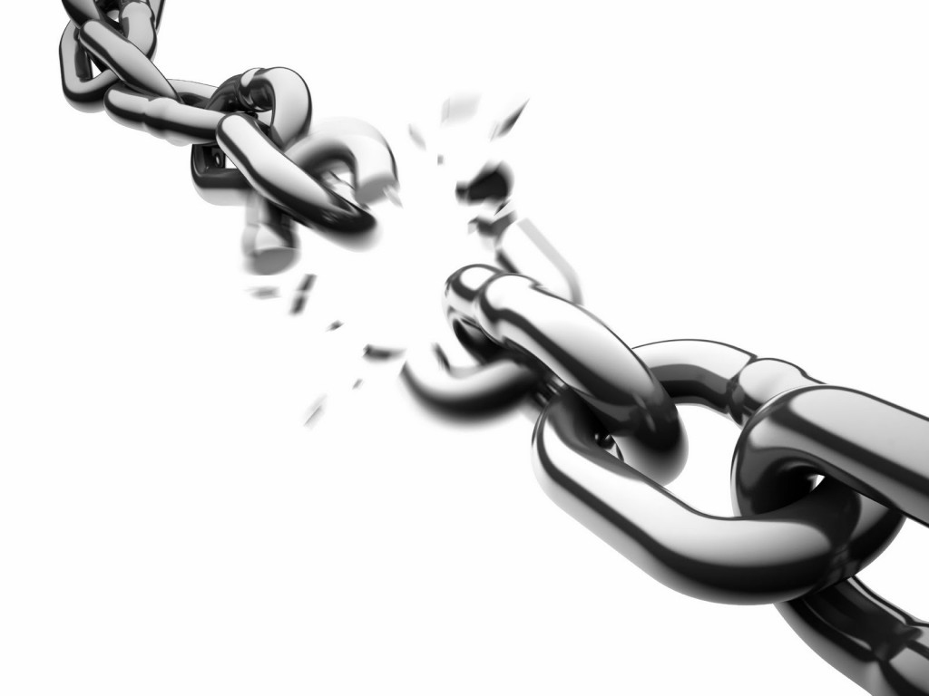
Becker Professional Theology Academy
BI100 – Module 2.3
Jesus Christ, the Perfect Sacrifice
By Kathy L. McFarland
Course Creator
12/19/2018

Slide 2
And ye know that he was manifested to take away our sins; and in him is no sin. 1 John 3:5
Jesus Christ was made known to the
world to take away our sins
Jesus Christ did NOT have venial, grave, or
original sin. He was pure and sin free.
Now then we are ambassadors for Christ, as though God did beseech you by us: we pray you in Christ’s stead, be ye reconciled to God. For he hath made him to be sin for us, who knew no sin; that we might be made the righteousness of God in him. (2 Corinthians 5:20–21)
Jesus Christ had no knowledge,
no understanding, of sin
Jesus Christ was made sin for us so we could obtain the same righteousness that Jesus possesses

Slide 3
Now then we are ambassadors for Christ, as though God did beseech you by us: we pray you in Christ’s stead, be ye reconciled to God. For he hath made him to be sin for us, who knew no sin; that we might be made the righteousness of God in him. (2 Corinthians 5:20-21)
The LORD God made Jesus to be sin for His people:
So they can become gods
So they can be righteous like Jesus
So they can be more righteous than Jesus
So the sacrifice of animals could end

Slide 4
It is NOT a believer’s conscience that
makes awareness of sin.
If I had not come and spoken unto them, they had not had sin: but now they have no cloke for their sin. He that hateth me hateth my Father also. If I had not done among them the works which none other man did, they had not had sin: but now have they both seen and hated both me and my Father.
(John 15:22-24)
It is NOT church doctrine that
makes awareness of sin.
The LORD God’s laws
makes believer’s aware of sin!
Jesus Christ’s teachings and the Holy Ghost’s presence makes believer’s aware of sin!

Slide 5
If I had not come and spoken unto them, they had not had sin: but now they have no cloke for their sin. He that hateth me hateth my Father also. If I had not done among them the works which none other man did, they had not had sin: but now have they both seen and hated both me and my Father. (John 15:22-24)
When Jesus speaks of “cloaked sin”:
“Cloaked sin” is NOT covered by shame, wickedness, or murkiness.
“Cloaked sin” IS covered by the pretext of ignorance

Slide 6
A person that appears ignorant of sin is really deeply aware of sin
Ignorance of sin does not mean that a sin is not present
If I had not come and spoken unto them, they had not had sin: but now they have no cloke for their sin. He that hateth me hateth my Father also. If I had not done among them the works which none other man did, they had not had sin: but now have they both seen and hated both me and my Father. (John 15:22-24)
A person that appears ignorant of sin, is allowing it to be covered by pretext of innocence
Once Christ speaks to a person, ignorant sin is brought to the forefront of awareness
What is the meaning of
"they had not sin?"

Slide 7
If I had not come and spoken unto them, they had not had sin: but now they have no cloke for their sin. He that hateth me hateth my Father also. If I had not done among them the works which none other man did, they had not had sin: but now have they both seen and hated both me and my Father. (John 15:22-24)
If a person hates the Lord Jesus Christ…
The person hates the LORD God!
If a person hates the Lord Jesus Christ and the LORD GOD…
The hatred toward Them is for the revelation of sin!

Slide 8
Moreover, brethren, I declare unto you the gospel which I preached unto you, which also ye have received, and wherein ye stand; By which also ye are saved, if ye keep in memory what I preached unto you, unless ye have believed in vain. For I delivered unto you first of all that which I also received, how that Christ died for our sins according to the scriptures; And that he was buried, and that he rose again the third day according to the scriptures: (1 Corinthians 15:1-4)
Three beliefs must hold true for a person to be delivered from
sin and made whole:
Jesus Christ DIED for
our sins
Jesus Christ was BURIED
Jesus Christ ROSE AGAIN TO LIFE on the third day

Slide 9
It was the LORD God who wounded and bruised the Lord Jesus Christ
Jesus Christ was wounded and bruised
for the Chosen Peoples’ rebellious
sin and immoral evil
Surely he hath borne our griefs, And carried our sorrows: Yet we did esteem him stricken, Smitten of God, and afflicted. But he was wounded for our transgressions, He was bruised for our iniquities: The chastisement of our peace was upon him; And with his stripes we are healed. (Isaiah 53:4-5)
When Christ was stricken, He lifted the Chosen Peoples’ sickness and prayed to the LORD God
Jesus Christ was given the responsibility
for the LORD God’s Chosen Peoples’
welfare and safety
When Jesus Christ became wounded, the Chosen People of God were cured of
their sins and made whole

Slide 10
All we like sheep have gone astray; We have turned every one to his own way; And the LORD hath laid on him the iniquity of us all. He was oppressed, and he was afflicted, Yet he opened not his mouth: He is brought as a lamb to the slaughter, And as a sheep before her shearers is dumb, So he openeth not his mouth. (Isaiah 53:6-7)
The LORD God’s Chosen People had moral evil of iniquity because:
They had gone astray
They had scattered to their own desires
They did NOT do what the LORD God willed

Slide 11
He was oppressed, and he was afflicted, Yet he opened not his mouth: He is brought as a lamb to the slaughter, And as a sheep before her shearers is dumb, So he openeth not his mouth. (Isaiah 53:7)
When the Lord Jesus Christ suffered the torturous afflictions before
his crucifixion did NOT open his mouth and speak
There was no reason for Christ to speak because his persecutors
were unable to hear or perceive his Word
He was taken from prison and from judgment: And who shall declare his generation? For he was cut off out of the land of the living: For the transgression of my people was he stricken. (Isaiah 53:8)
The LORD God required Christ to be crucified; imprisonment and judgment of man was not desired
The LORD God allowed the enemies of Jesus Christ to wound him and crucify him; that is all

Slide 12
And he made his grave with the wicked, And with the rich in his death; Because he had
done no violence, Neither was any deceit in his mouth. (Isaiah 53:9)
The Lord Jesus Christ died and went to Hell following his crucifixion.
There are many people that will follow the same path that Jesus Christ suffered, such as:
Wicked
Immoral
Ungodly
Condemned
Bad
Lustful
Rich

Slide 13
And he made his grave with the wicked, And with the rich in his death;
Because he had done no violence, Neither was any deceit in his mouth. (Isaiah 53:9)
The Lord Jesus Christ could have avoided crucifixion by choosing to…
But he did NOT! Jesus Christ DID NOT do violence,
lie, or lose his righteousness because he chose not to
Lie
Resort to violence
Lose his righteousness

Slide 14
Please proceed to BI100, Module 2.4, Jesus Christ the Perfect Sacrifice (Continued)

