Slide 1
Becker Professional Theology Academy
B100 – Module 5.3 – Baptism
(Jesus Christ)
Course Creator – Kathy L. McFarland
http://becker.academy/moodle/

Slide 2
John told the gathered crowd that the one coming would baptize with the Holy Ghost
and with fire
But John told the crowd that there would be
one coming that was mightier than him
And as the people were in expectation, and all men mused in their hearts of John, whether he were the Christ, or not; John answered, saying unto them all, I indeed baptize you with water; but one mightier than I cometh, the latchet of whose shoes I am not worthy to unloose: he shall baptize you with the Holy Ghost and with fire: Whose fan is in his hand, and he will thoroughly purge his floor, and will gather the wheat into his garner; but the chaff he will burn with fire unquenchable.
(Luke 3:15–17)
There were some that thought John the Baptist was actually the prophesied Messiah
John said the one that would soon come is so great that he would
be unworthy to
loose his shoes

Slide 3
John answered, saying unto them all, I indeed baptize you with water; but one mightier than I cometh, the latchet of whose shoes I am not worthy to unloose: he shall baptize you with the Holy Ghost and with fire: Whose fan is in his hand, and he will thoroughly purge his floor, and will gather the wheat into his garner; but the chaff he will burn with fire unquenchable. (Luke 3:16-17)
The procedures and processes of the Holy Spirit Baptism will be studied in more detail in Module 6. For now, lets go back to the Water Baptism received by Jesus Christ through John the Baptist.
John’s Baptism of Repentance is done with water
Christ’s Baptism of Redemption gives the Holy Ghost to a believer
Those baptized with the Holy Ghost receive the Baptism of Fire
The Holy Spirit and His Fire are inside those believers baptized in Christ
Most Christian leaders pray and lay hands upon a newly baptized believer…
…To transfer a part of the Holy Spirit into a baptized believer
The fire of the Holy Spirit purges the believer of sin
Holy Spirit fire reveals the good works of the Lord within a believer

Slide 4
As it is written in the prophets, Behold, I send my messenger before thy face, which shall prepare thy way before thee. The voice of one crying in the wilderness, Prepare ye the way of the Lord, make his paths straight. John did baptize in the wilderness, and preach the baptism of repentance for the remission of sins. And there went out unto him all the land of Judaea, and they of Jerusalem, and were all baptized of him in the river of Jordan, confessing their sins. (Mark 1:2–5)
John the Baptist preached the
BAPTISM OF REPENTANCE FOR THE REMISSION OF SINS

Slide 5
VERY IMPORTANT NOTE:
Jesus Christ was not baptized until John had baptized “all the people. “ Many of those receiving John’s Baptism of Redemption later became followers of Christ, and were prepared to receive the Baptism of Holy Spirit in the future.
Now when all the people were baptized, it came to pass, that Jesus also being baptized, and praying, the heaven was opened, And the Holy Ghost descended in a bodily shape like a dove upon him, and a voice came from heaven, which said, Thou art my beloved Son; in thee I am well pleased. (Luke 3:21–22)
Following Christ’s water baptism, The Holy Ghost came upon him from heaven in bodily shape “like a dove.” The Holy Spirit descended from Heaven to Christ on earth to come upon him. The “dove” is a popular representation
of the Holy Spirit in denominational logos and biblical artwork.
Those standing around Jesus Christ to witness his baptism were convinced that he was the Son of God because the LORD God announced that fact in saying “Thou art my beloved Son; in thee I am well pleased.”

Slide 6
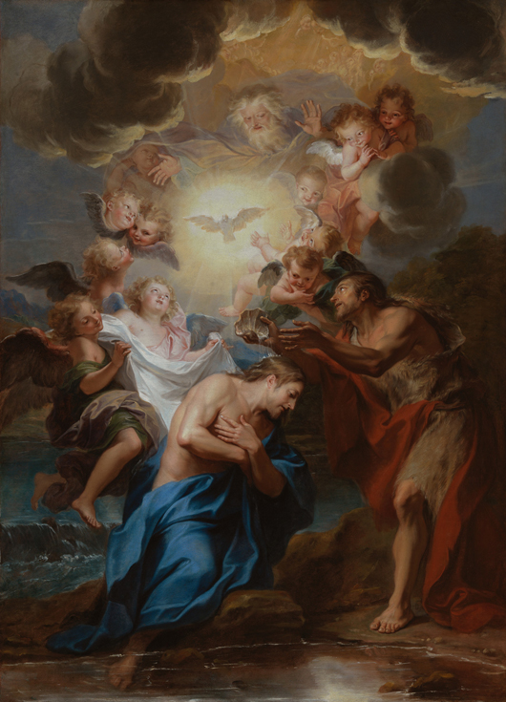
The Baptism of Christ
Antoine Coypel (France, Paris, 1661-1722)
www.lacma.org

Slide 7
Then cometh Jesus from Galilee to Jordan unto John, to be baptized of him. But John forbad him, saying, I have need to be baptized of thee, and comest thou to me? And Jesus answering said unto him, Suffer it to be so now: for thus it becometh us to fulfill all righteousness. Then he suffered him. And Jesus, when he was baptized, went up straightway out of the water: and, lo, the heavens were opened unto him, and he saw the Spirit of God descending like a dove, and lighting upon him: And lo a voice from heaven, saying, This is my beloved Son, in whom I am well pleased. (Matthew 3:13–17)
Jesus Christ was NOT baptized to rid himself of original sin. He was without sin.
Jesus Christ WAS baptized to “FULFILL ALL RIGHTEOUSNESS”
Jesus Christ was NOT baptized to show people a better way to be saved.
Righteousness, δικαιοσύνη (dikaiosynē), word usage in Matthew 3:15 speaks specifically about the
idea of “to put right with” especially with regards to a “religious obligation.” (Strong’s Greek 1466) .
The Bible Sense Lexicon goes further into the definition, and stresses it is
“life or lifestyle in conformity to justice, law, or morality as given by God.”
Jesus Christ’s baptism fulfilled the LORD God’s expectation of his conformity to the right things of God.
Jesus Christ was NOT baptized to rid the world of sin.

Slide 8
Jesus had important things to say about John the Baptist
And when the messengers of John were departed, he began to speak unto the people concerning John, What went ye out into the wilderness for to see? A reed shaken with the wind? But what went ye out for to see? A man clothed in soft raiment? Behold, they which are gorgeously appareled, and live delicately, are in kings’ courts. But what went ye out for to see? A prophet? Yea, I say unto you, and much more than a prophet. This is he, of whom it is written, Behold, I send my messenger before thy face, which shall prepare thy way before thee. For I say unto you, Among those that are born of women there is not a greater prophet than John the Baptist: but he that is least in the kingdom of God is greater than he. And all the people that heard him, and the publicans, justified God, being baptized with the baptism of John. But the Pharisees and lawyers rejected the counsel of God against themselves, being not baptized of him. (Luke 7:24–30)

Slide 9
Jesus Christ’s comments about John the Baptist…
John’s teachings of LORD God and His Son Jesus Christ are not doctrines that change often like a reed blowing in the wind
(Luke 7:24)
Those seeking John’s teachings knew they would find him in the wilderness, not in
a king’s court
(Luke 7:24, 25)
John’s clothing choice was not one of soft fabric, but instead,
of rough camel’s
hair and skin
(Luke 7:25)
The LORD God’s prophet is neither gorgeously appareled nor given noble settings to speak God’s Words
(Luke 7:25)
John is a prophet of the LORD God, and he is much more than just a prophet to prepare the way for Christ to come (Luke 7:26, 27)
There is no greater prophet than John the Baptist; he was chosen
as God’s messenger
(Luke 7:28)
Even though John is the greatest prophet ever born of women, believers least in the kingdom of God is greater than him
(Luke 7:28)
Those that heard John’s preaching justified
God. But those unbaptized rejected
the counsel of God.
(Luke 7:29-30)

Slide 10
Pharisees and Lawyers refused to be baptized by John the Baptist (Luke 7:27-30)
Pharisees were religious separatists during the time of Christ
Pharisees were sanctimonious, hypocritical, and self-righteous. They were heretical advocates of ceremonies without regard for God. They were smugly moralistic and intolerant of other’s opinions. They pretended to have superior moral,
religious beliefs and principles that they did not possess.

Slide 11
And it came to pass, that, while Apollos was at Corinth, Paul having passed through the upper coasts came to Ephesus: and finding certain disciples, He said unto them, Have ye received the Holy Ghost since ye believed? And they said unto him, We have not so much as heard whether there be any Holy Ghost. And he said unto them, Unto what then were ye baptized? And they said, Unto John’s baptism. Then said Paul, John verily baptized with the baptism of repentance, saying unto the people, that they should believe on him which should come after him, that is, on Christ Jesus. When they heard this, they were baptized in the name of the Lord Jesus. And when Paul had laid his hands upon them, the Holy Ghost came on them; and they spake with tongues, and prophesied. (Acts 19:1-6)
Three Different Baptisms Mentioned in Acts 19:1-6
Baptism of John
Baptism of Jesus Christ
Baptism of the Holy Ghost

Slide 12
The Baptism of John was done before Christ. It is called the Baptism of Repentance.
The Greek Word “μετάνοια (metanoia)” is used to represent the word repentance; this type of repentance is
“a change of mind results in a change of lifestyle.”¹
Those that were baptized by John required a new Baptism of Jesus Christ to obtain “redemption.”
¹ James Swanson, Dictionary of Biblical Languages with Semantic Domains: Greek (New Testament) (Oak Harbor: Logos Research Systems, Inc., 1997) (3567).

Slide 13
The Baptism of Jesus Christ can only be received by a Believer when the Word of God can be heard. It is only the opening of the hearing by the LORD God that allows people to hear the Gospel of Christ. (Acts 19:5)
All Believers that faithfully declare the Lord Jesus Christ as Savior should be baptized into Christ’s “ Baptism of Redemption.” The Greek word ἀπολύτρωσις (apolytrōsis)¹ speaks of a ransom, deliverance, release. The Baptism of Redemption brings death to the sinner in the baptismal waters, thereby releasing the sin. The Believer is then resurrected into life as he rises from the baptismal waters through the pattern that the Lord Jesus Christ overcame death. The faithful Believer is redeemed by the shed blood of Christ and will live eternal forever according to the promises of the LORD God. This Baptism equips believers to experience this process before natural death.
In the next module we will analyze the process of the Baptism of Redemption in great detail. It is important to note that the Baptism of the Holy Spirit cannot be accomplished until the believer has received the Baptism of Jesus Christ and redeemed the promise of salvation through the release of sin.
¹ James Swanson, Dictionary of Biblical Languages with Semantic Domains: Greek (New Testament) (Oak Harbor: Logos Research Systems, Inc., 1997) (667).

Slide 14
Please continue to next BI100 – Module 5.4 – Baptism of Redemption
(Romans 6:1-11)

